Slide 1







Capstone Project
Stack Overflow Developer Survey – 2019 Analysis
Nathan Chan
August 1, 2023

Slide 2



OUTLINE
OUTLINE
Executive Summary
Introduction
Methodology
Results
Visualization – Charts
Dashboard
Discussion
Findings & Implications
Conclusion
Appendix

Slide 3

EXECUTIVE SUdMMARY
Current Technology Usage
Top 10 Languages Worked with
Top 10 Databases Worked with
Platforms as presented by Word Cloud
Top 10 Web Frames worked with
Future Technology Trend
Top 10 Languages Desired Next Year
Top 10 Databases Desired Next Year
Platforms worked with Desired Next Year
Top 10 Web Frames Desired Next Year
Demographics
Respondents Classified by Gender
Respondent Count for Countries
Respondent Count by Age
Respondent Count by Gender by Formal Education Level
EXECUTIVE SUMMARY

Slide 4

INTRODUCTION
This is a report written for Stack Overflow’s annual Developer Survey. It is the world’s largest and most comprehensive survey of people who code around the world.
Nearly 90,000 developers.
Trends of predictive analysis and characterization of developers around the globe.
INTRODUCTION

Slide 5

METHODOLOGY
Collecting Data – Stack Overflow Developer Survey – 2019
Using – API.
Using – Web scraping.
Exploring Data
Finding Duplicates & Removing Duplicates.
Finding & Imputing Missing Values.
Normalizing Data
Handling Outliers
Correlation
Visualization Data
Visualization Distribution, Relation, Composition & Comparison of data.
Building Dashboard.
METHDOLOGY

Slide 6
RESULTS

Slide 7
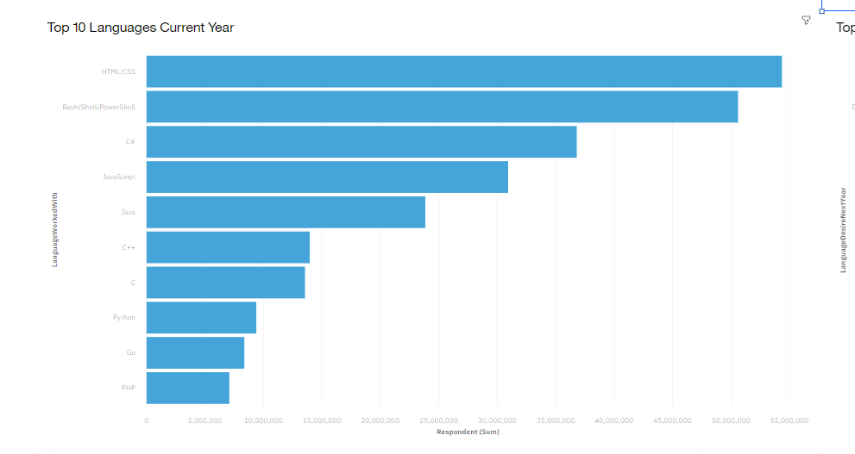
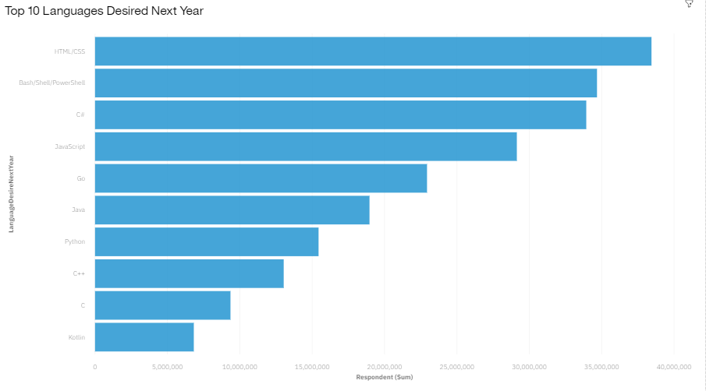
PROGRAMMING LANGUAGE TRENDS
Current Year
Next Year

Slide 8
PROGRAMMING LANGUAGE TRENDS - FINDINGS & IMPLICATIONS
Findings
HTML/CSS appears to be a popular choice for the current year as well as the future.
PHP comes as the least popular for the current year and Kotlin appears as the least choice for the next year.
JavaScript and Java appear to be a mid-popular choice for the current year and next year respectively.
Implications
HTML/CSS is becoming the new and upcoming popular and demanding programming language among users.
PHP and Kotlin have been replaced by other programming languages at most places.
JavaScript and Java appear to be medium demand programming languages.

Slide 9
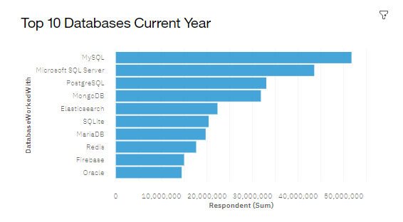
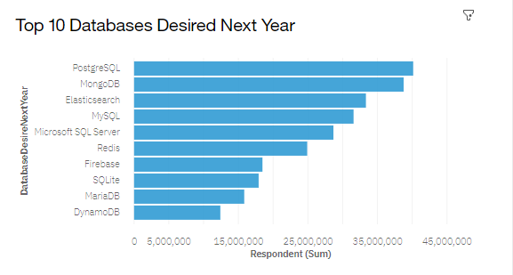
DATABASE TRENDS
Current Year
Next Year

Slide 10
DATABASE TRENDS - FINDINGS & IMPLICATIONS
Findings
MySQL comes out to be a popular choice of database for the current year whereas PostgreSQL is the select database desired in the future
Oracle comes as the least popular for the current year and DynamoDB as well for the next year as well.
Looking to the future, PostgreSQL, MongoDB, Elasticsearch, MySQL, and Microsoft SQL Server appear to be the most trending databases.
Implications
PostgreSQL is becoming the new upcoming popular desired database skill among users replacing MySQL.
Oracle has been replaced by other programming languages at most places.
PostgreSQL, MongoDB, Elasticsearch, MySQL, and Microsoft SQL Server appear to be the more popular desired choices of databases in the future.

Slide 11

DASHBOARD
The permanent link of the read-only view of the Cognos dashboard is as follows:
https://dataplatform.cloud.ibm.com/dashboards/c4f0dc2a-e661-4f6e-b01c-2f962861a8c8/view/6601eb2c0fa902c971b6bde4079a2e547831225ae6bb8a5085807b490e332297a96a1494c87d4e09de450762f5b8160fcb

Slide 12
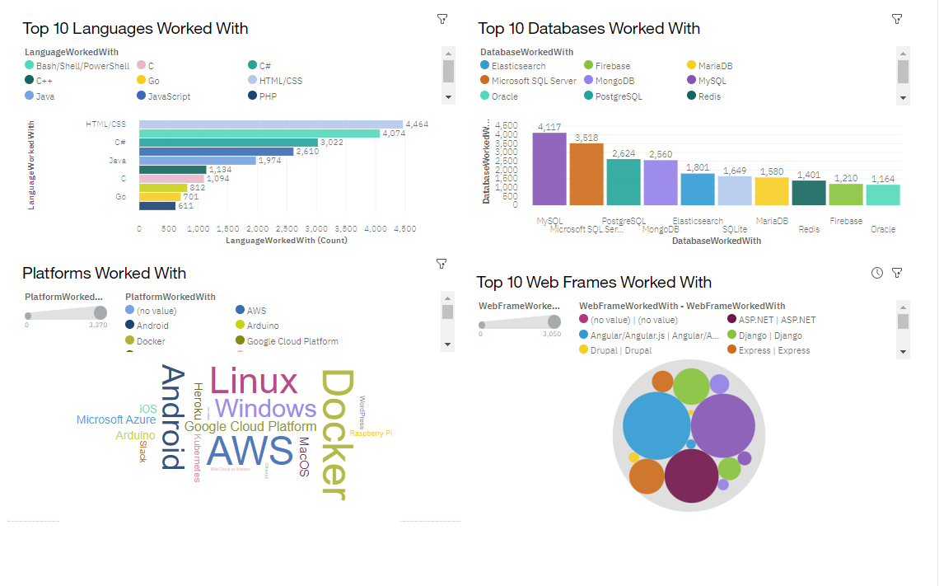
DASHBOARD TAB 1

Slide 13
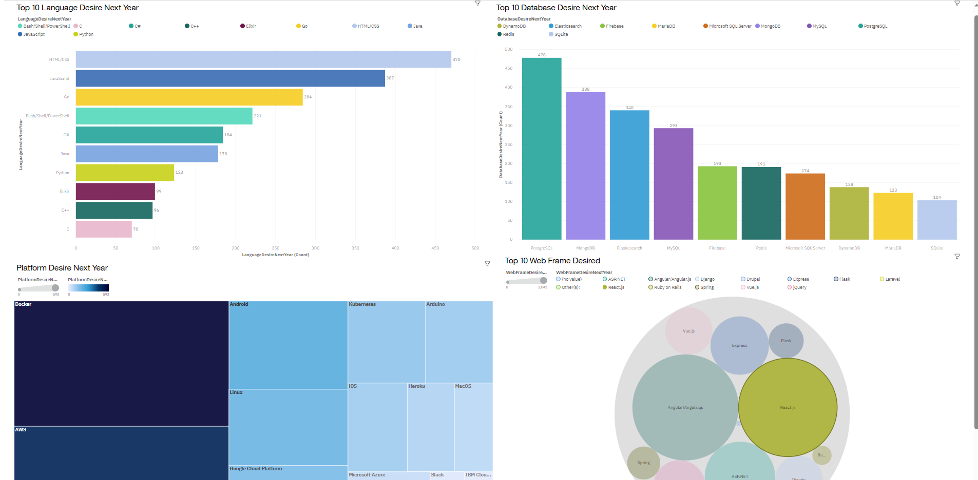
DASHBOARD TAB 2

Slide 14
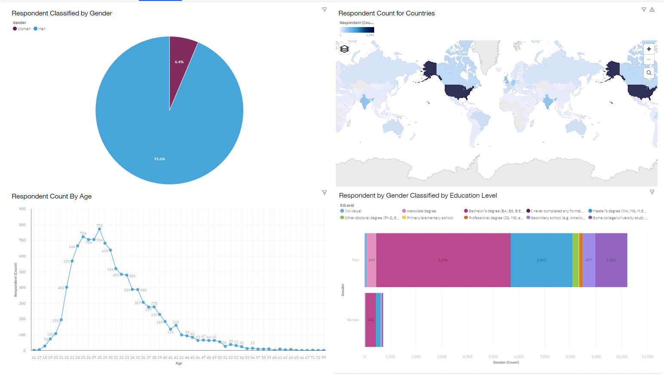
DASHBOARD TAB 3

Slide 15
DISCUSSION
All ages used for survey. Outliers filtered out.
All genders were considered for this survey.
People from across various countries were asked for the survey.
Various people with different educational levels were included as well.

Slide 16
OVERALL FINDINGS & IMPLICATIONS
Findings
The upcoming languages trend is for web languages like HTML/CSS and scripting languages like Bash/Shell/PowerShell.
The upcoming trend for relational database usage is PostgreSQL.
Docker appears to be the most used platform and continues to be the future platform of use.
Implications
People are looking towards web languages and shell scripting in the future.
Relational databases are the trending options for the future!
Docker is the dominant platform for all platforms.

Slide 17

CONCLUSION
The top language in demand of present and future is HTML/CSS.
The top database in demand:
Present – MySQL; Future - PostgreSQL
The most popular platform is Docker.
The top web frame in demand for present and future is Angular.js.

Slide 18
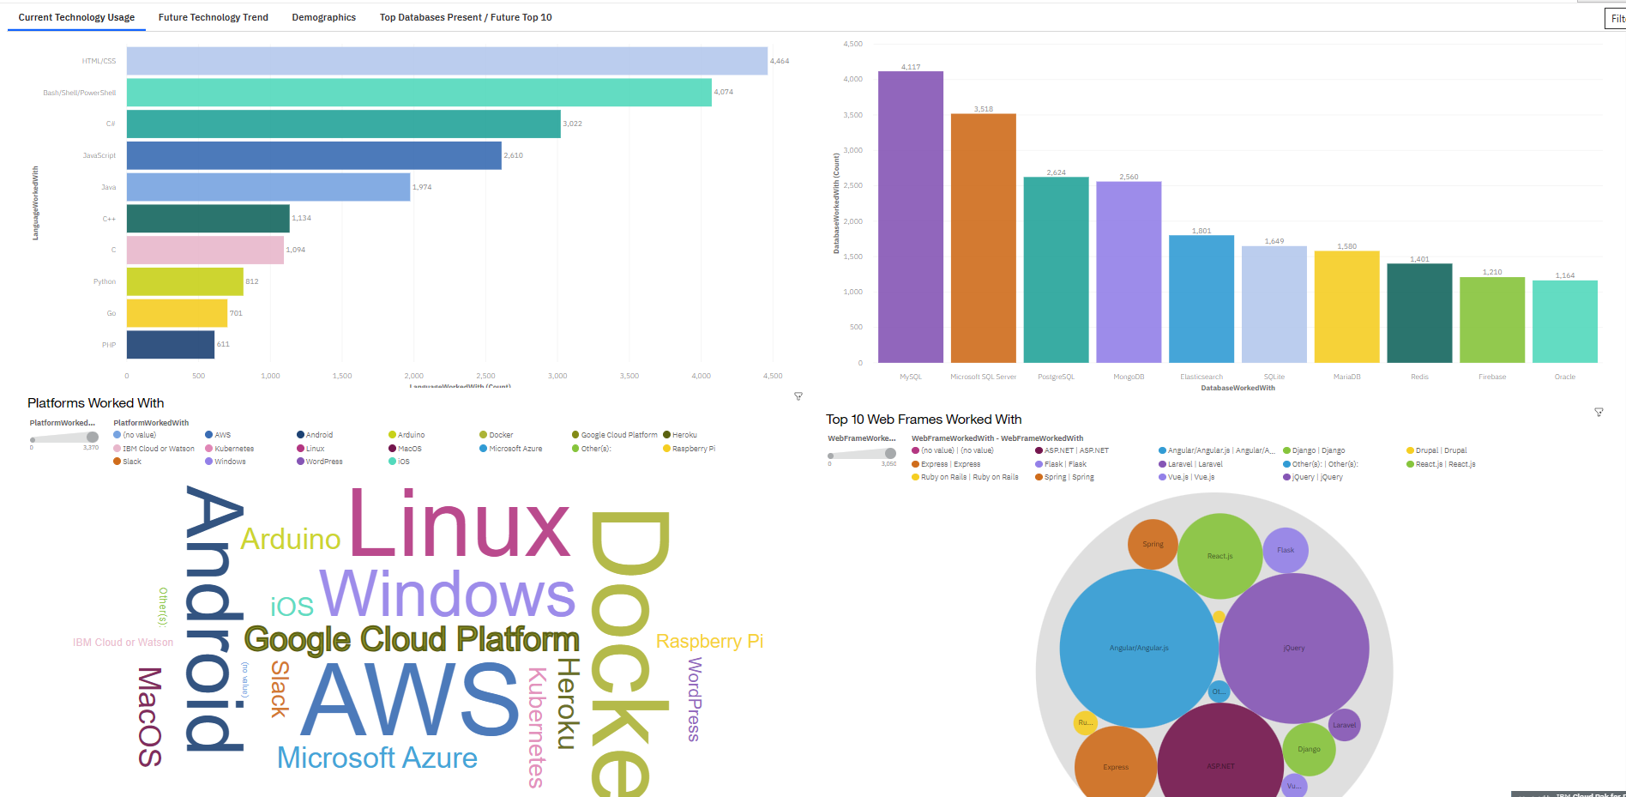

APPENDIX

Slide 19
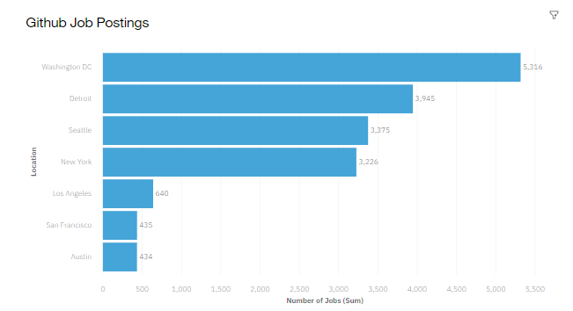
JOB POSTINGS

Slide 20
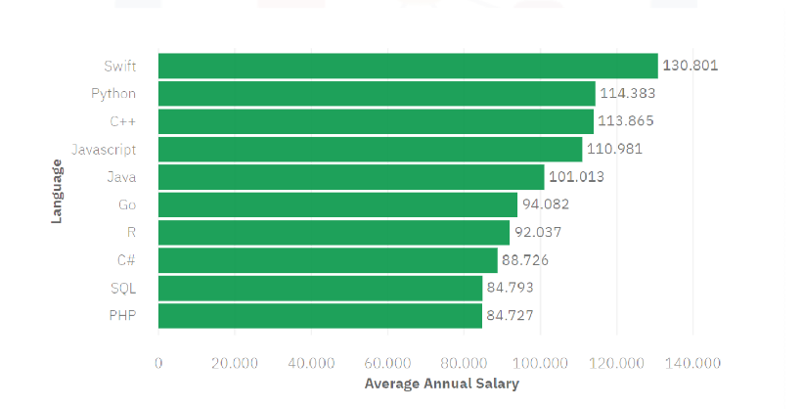
POPULAR LANGUAGES
Popular Languages and Average Annual Salary

